Slide 1
Human Computer Interaction
Presentation on Projects(1-3)
Group M01, Mon 12-14
Julian Jürgen Janson (2548428)
Hassan Mahmoud Soliman (2576774)
Koushik Chowdhury (2572865)

Slide 2
Observing People while doing exercises in Project 1
People were a little stressed or worried about being observed
Identifying what exactly the type of characteristics or capabilities that should be recorded
Couldn’t find different contexts to observe people other than individuals

Slide 3
How have they been addressed?
I just asked them to feel free to do anything they want in the fitness trail, then I took aside and left them experimenting while I took notes
Other than basic characteristics like “Age”, “Height”, “Weight”. I thought that also “Physique” and “Strength” are highly correlated with their ability to do some of the exercises

Slide 4
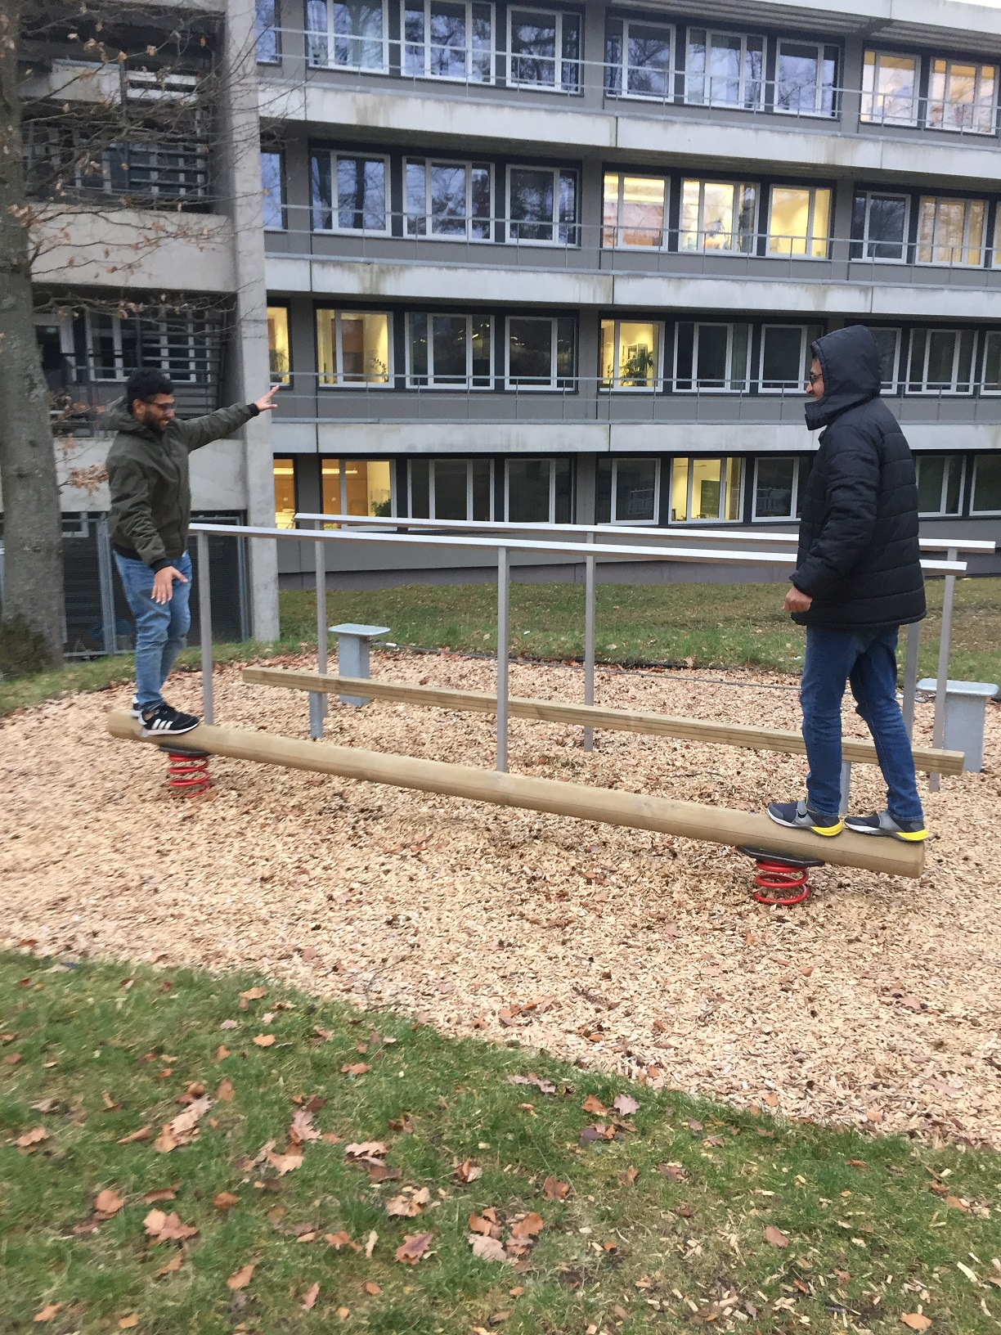
Tried to observe context of groups by asking a couple of individuals to perform a certain exercise together and they came up with new ideas of how to do the exercise

Slide 5
Outcome of addressing the challenges
People started to feel natural about trying to do different exercises
People with bulky “Physique” and high “Strength” could do tougher exercises than the others
I could observe a context of groups doing the exercises and they came up with new ideas doing it together

Slide 6
First Step of Design a Interface
Look at other Applications
Hidden Menu
Only Buttons (Mensa App)
Buttons combined with other functions

Slide 7
Drawing Interface
Draw and got feedback
How to design this in detail ?
Design of other functions
Connection between this

Slide 8
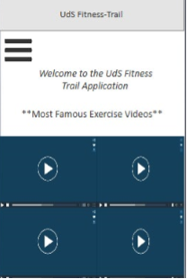
Chosen Design
Drop down menu
Much space
Common used

Slide 9
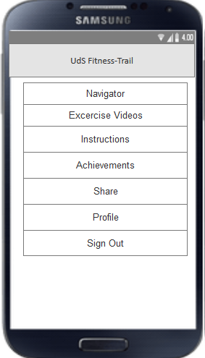
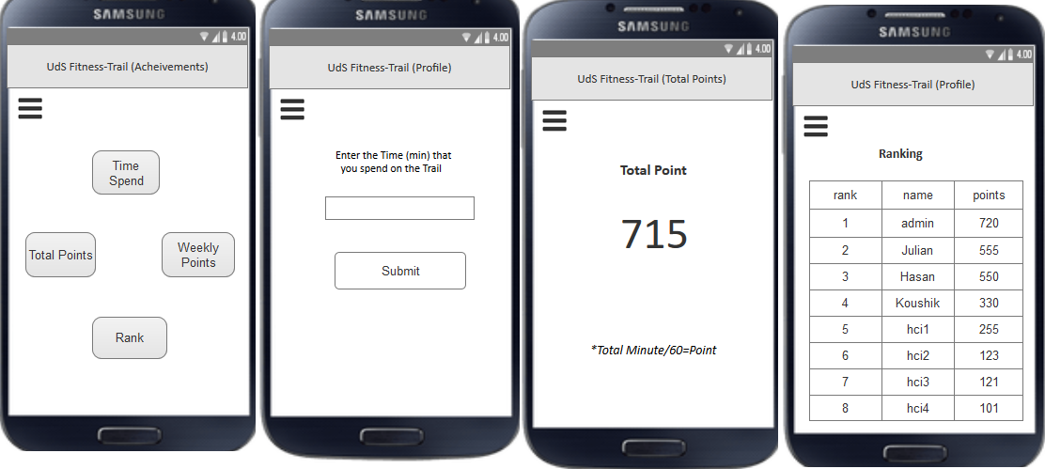
Design a Prototype and getting feedback

Slide 10
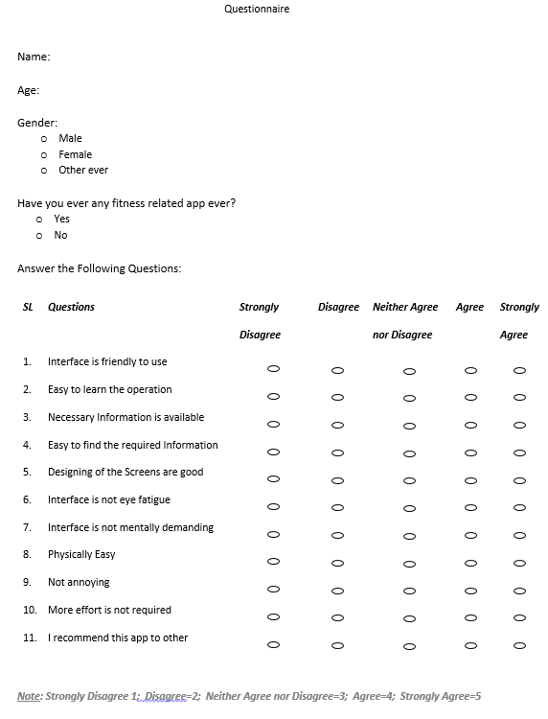
Feedback

Slide 11
Feedback (Cont.)
Interviews
1. What do you think about this application?
2. What is your experience in terms of finding the fitness trail location and instructions by this application?
3. What is/are the most complex functionality of this application?
4. How this application motivate people to use fitness trail?
5. How can this application be more improved?
6. What are struggle that you face to use this application?
7. Do you have any other thoughts about the struggled issues?
8. Describe the things that you enjoyed when you were using this application?
9. What functionality should have been added?
10. What is your overall impression about this application? Do you recommend this app to other? If not, why?

Slide 12
Thank you

